Slide 1
DBMS FINAL PROJECT
LIBRARY MANAGEMENT SYSTEM
USING SQL

Slide 2
GROUP MEMBERS
M JUNAID RIAZ 43997
M SHEHRYAR AHMAD 47435
AHMAD ABU BAKR 44352

Slide 3
Project’s Introduction
The Library Management System (LMS) is a software application designed to handle the core functions of a library. This includes managing book inventories, keeping track of borrowed and returned books, managing member information, and processing transactions efficiently. By automating these tasks, the LMS helps improve the operational efficiency of the library, reducing the manual workload on librarians and making it easier for users to access library services.

Slide 4
Existing Models/Literature Review
Libraries have evolved from manual record-keeping methods to more sophisticated digital systems:
Manual Systems: Traditionally, libraries relied on physical catalog cards and ledgers. This method was time-consuming and prone to errors.
Basic Database Systems: Early digital libraries used simple databases to store information about books and members. These systems often lacked user-friendly interfaces and advanced features like search functionality.
Integrated Library Systems (ILS): Modern ILS are comprehensive solutions that integrate various functions of library management. They offer features such as online catalogs, member management, transaction tracking, and reporting tools. Examples include systems like Koha and Evergreen.

Slide 5
System Model
The Library Management System includes the following main components:
Books: Information about books, including title, author, ISBN, and availability status.
Members: Information about library members, including member ID, name, contact details, and membership status.
Transactions: Records of borrowing and returning books, including transaction ID, book ID, member ID, issue date, and return date.

Slide 6
WORKING
Adding Books: Librarians can add new books to the system with details like title, author, and ISBN.
Registering Members: New members can be registered with their personal details.
Borrowing Books: Members can borrow books, and the transaction is recorded with issue date and return date.
Returning Books: When books are returned, the transaction record is updated.
Viewing Records: Librarians can view all books, members, and transaction records.

Slide 7
SIMULATION/RESULTS
Simulations of the Library Management System demonstrate the following results:
Efficiency: The system significantly reduces the time and effort required for book and member management.
Accuracy: Automated transaction recording minimizes errors compared to manual record-keeping.
Accessibility: Users can easily search for books and check their availability.
Scalability: The system can handle a large number of records and transactions, making it suitable for libraries of various sizes.

Slide 8
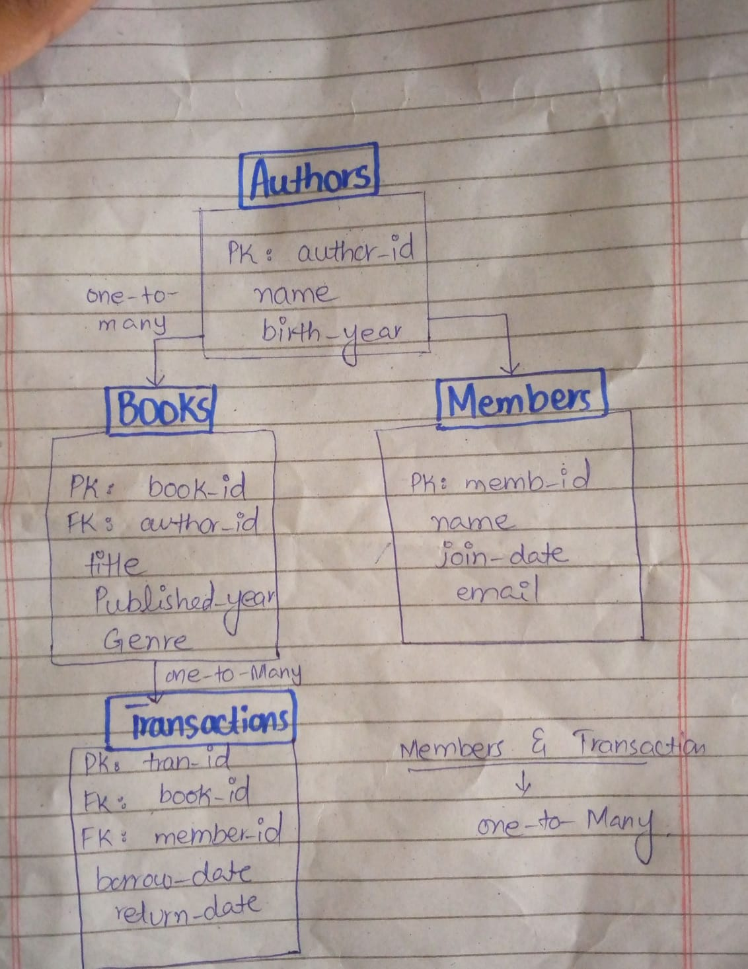
ERD

Slide 9
GITHUB LINK
https://github.com/Ab3467/DBMS-project

